Slide 1
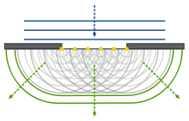
Lecture 3
Chemical Engineering for Micro/Nano Fabrication

Slide 2
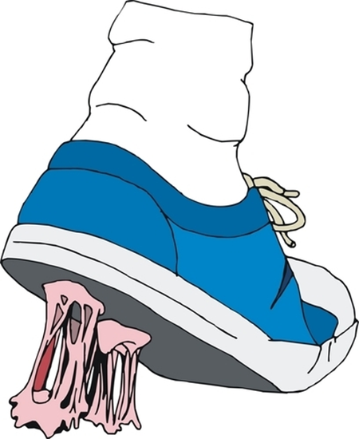
Modulation in Contact Printing
RESIST
MASK
WAFER
ILLUMINATION
I_{max} – I_{min}
I_{max} + I_{min}
MODULATION =
1
Modulation of the mask is ?
Modulation of the image is ?
~1
The image is almost perfect!
Notes:
Problem is that the mechanical contact between the mask and wafer causes defects on the mask and wafer with consequent negative impact on productivity.

Slide 3
Some change required to go forward
As dimensions decrease, so do yields!
Serious Problems with Mask Contamination
Rubber resist and Emulsion Masks
Introduction of Chromium on glass masks
Alignment was done external to the Exposure system
Slow production and low yield = ☹
Just move the mask away and do…
“Proximity Printing”

Slide 4
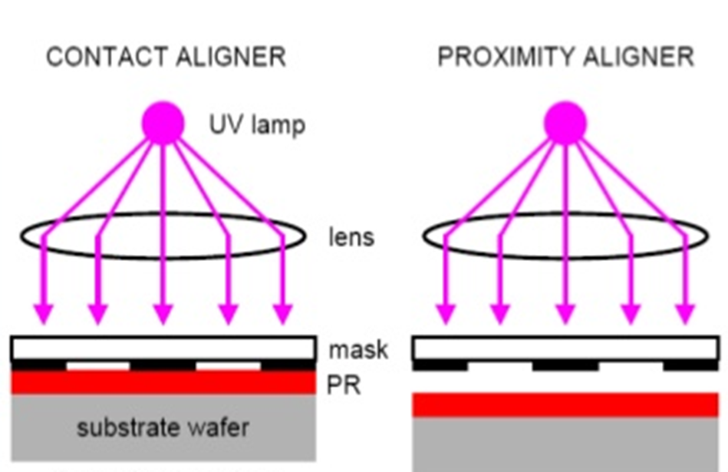
But…..Nothing is Simple

Slide 5
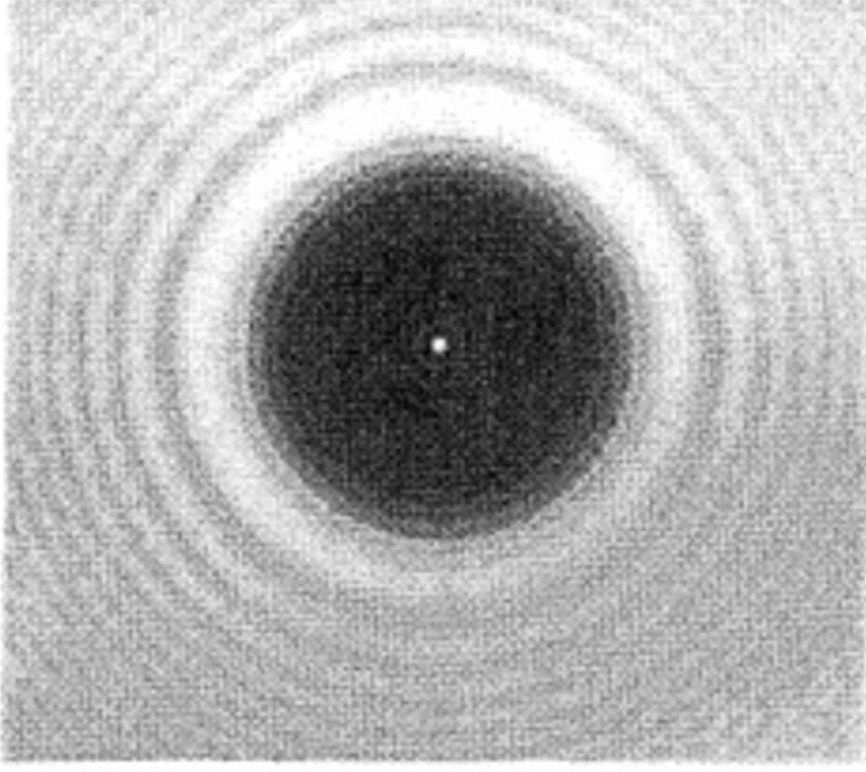
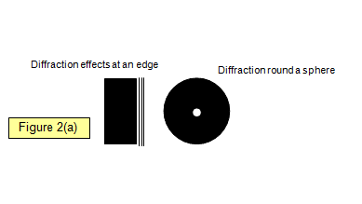
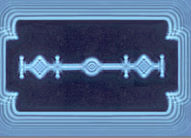
Nothing is Simple…it seems
Newton vs Fresnel
Diffraction rears it’s head
Notes:
Hence the introduction of proximity printing. However, the resolution degrades significantly at practical mask gaps.
Typical separation in proximity printing is 20 – 50 um

Slide 6
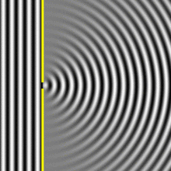
Huygens’ Theory
When w = λ 1 wavelet
Many wavelets that interact
Wavelets

Slide 7
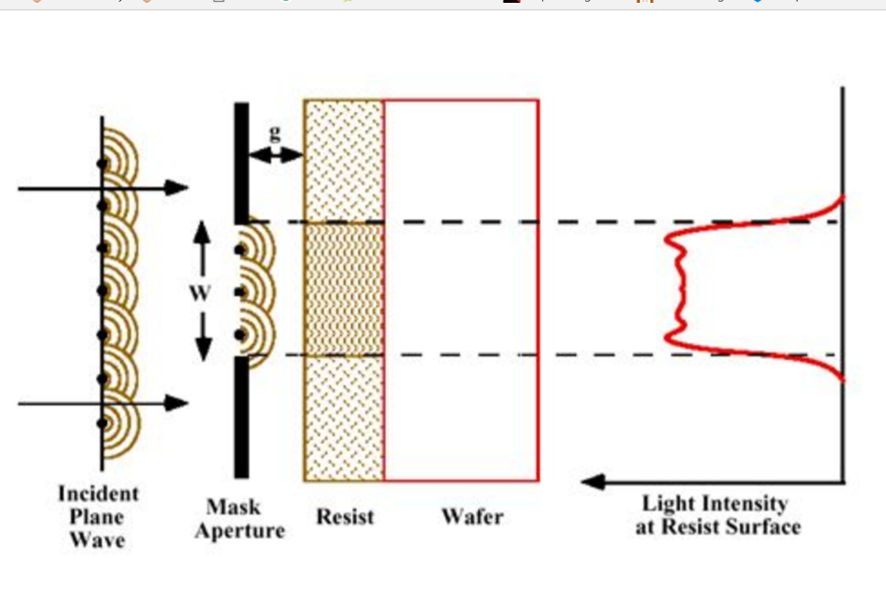
Fresnel Diffraction in Proximity Printing
Near field or Fresnel Diffraction Regime When g < W²/λ
Image can be constructed from point sources of spherical wavelets in the opening (Huygens’ Theory)
There is interference between these waves that causes “ringing”
Here the minimum feature size is W ~ $√$λg
For g = 20 μm and 365 nm light, W is on the order of 2.7 μm

Slide 8
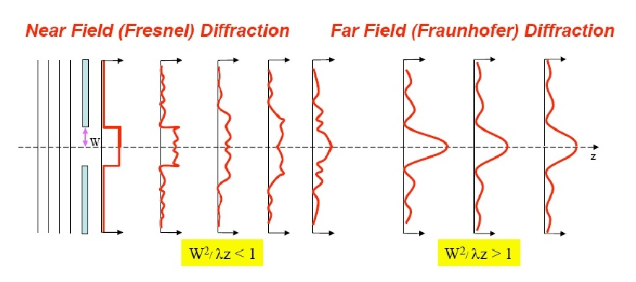
We also have have Frauenhofer Diffraction
Far Field Diffraction.

Slide 9
Brief Look at Diffraction
Some Excellent Video Lessons
https://www.youtube.com/watch?v=blur0MemUQA
1. Constructive and destructive Interference
https://www.youtube.com/watch?v=7CmbItRjM-Y
2. Single Slit Diffraction
https://www.youtube.com/watch?v=Iuv6hY6zsd0
3. Double slit waves 2:00
https://www.youtube.com/watch?v=PgW7qaOZD0U
4. Single slit diffraction demonstration
https://www.youtube.com/watch?v=nuaHY5lj2AA
5. Double Slit Demonstration
https://www.youtube.com/watch?v=Pk6s2OlKzKQ
6. Double slit Diffraction – Part 1
https://www.youtube.com/watch?v=1abpdO27KTo
7. Double Slit Diffraction - Part 2

Slide 10
…When the width is small the gap must be small
So ….. we can do projection printing
and get the mask far away from the wafer

Slide 11
Optical Aligner Design Principles

Slide 12
Advantages of Projection Printing
Non-contact operation which prevents the mask from introducing defects and wearing out.
No need for replacement masks.
Wafer images are potentially more uniform because a single “mask” is used for all of them.
Improved alignment accuracy – no need to move the wafer after alignment.
Reduction capability makes masks easier to fabricate and repair.
Mask can be protected with a pellicle

Slide 13
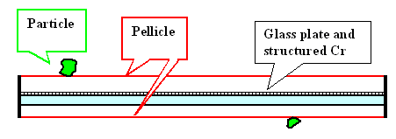
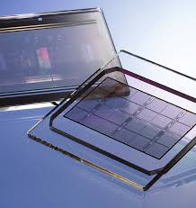
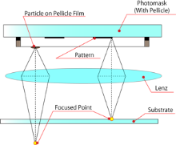
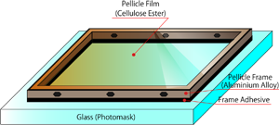
The Pellicle

